Slide 1
Grocery Stores
Sales Data
Presented by Data Scientist
Ryan Cannady

Slide 2
Sales Data
Data is very important going into the future.
I will give you some recommendations and visuals to help you better understand how to improve sales data.

Slide 3
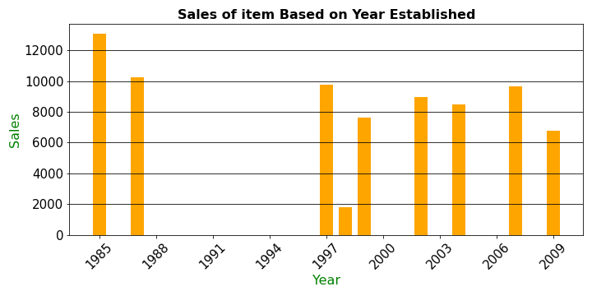
Patience is a virtue!!
This chart shows total sales based on year established

Slide 4
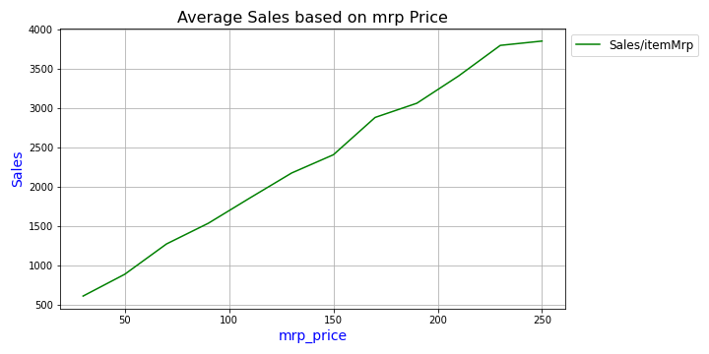
As you can see the total sales goes up as the average mrp price goes up!
This chart shows the total sales per item cost.

Slide 5

Predictive Modeling!
For the predictive model recommendation
I recommend regression tree modeling!
Basically which means the sales can be predicted by choosing different branches on a tree over and over again until you are out of branches to decide from!

Slide 6

Recommendations
Patience!
The best sales performance come from store that have been established awhile!
Also make sure you have more expensive items.
Check on your stores established in 1998
the sales are very low!

